Slide 1
Portfolio
Course Code: CSE-0317
Course Name: Software Engineering Lab
Submitted To: Khan Md. Hasib
Lecturer Dept. Of CSE
State University Of Bangladesh
Submitted By: Abu Noman Farhad
ID: UG02-48-18-009

Slide 2
Outline
Introduction
Types of Portfolios
When and why do you use portfolios?
Requirement
Home page
Advantages
Disadvantages
Conclusion

Slide 3
Introduction
A professional portfolio is a tool judiciously and carefully crafted to appropriately showcase the work of a professional while providing evidence of career growth.

Slide 4
Types of Portfolios
SHOWCASE
PROCESS
ASSESSMENT

Slide 5
When and why do you use portfolios?
Portfolios are a great way to demonstrate the competencies you would list on a resume or talk about in an interview, they allow you to show and not just tell. During a job search, the portfolio showcases your work to potential employers. It presents evidence of your relevant skills and abilities.

Slide 6
Requirement
HTML
CSS
XAMPP
Visual Studio Code
JavaScript
PHP
Brower
Database

Slide 7
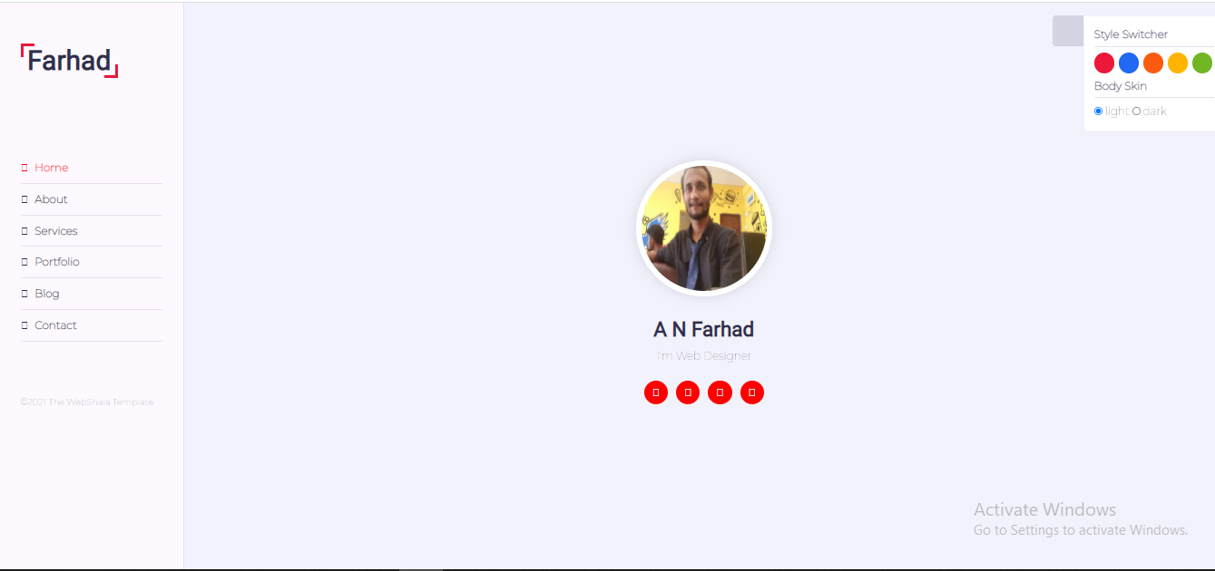
Home page

Slide 8
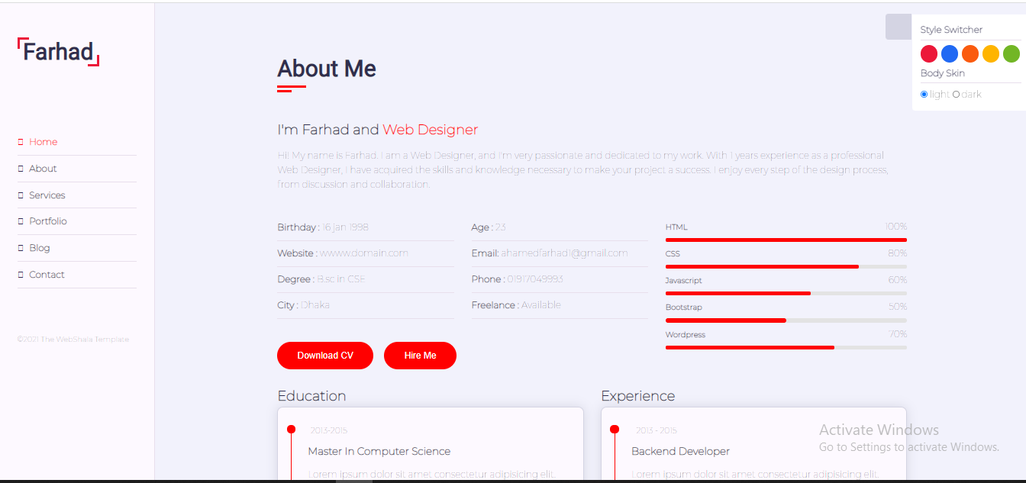
About Me Page

Slide 9
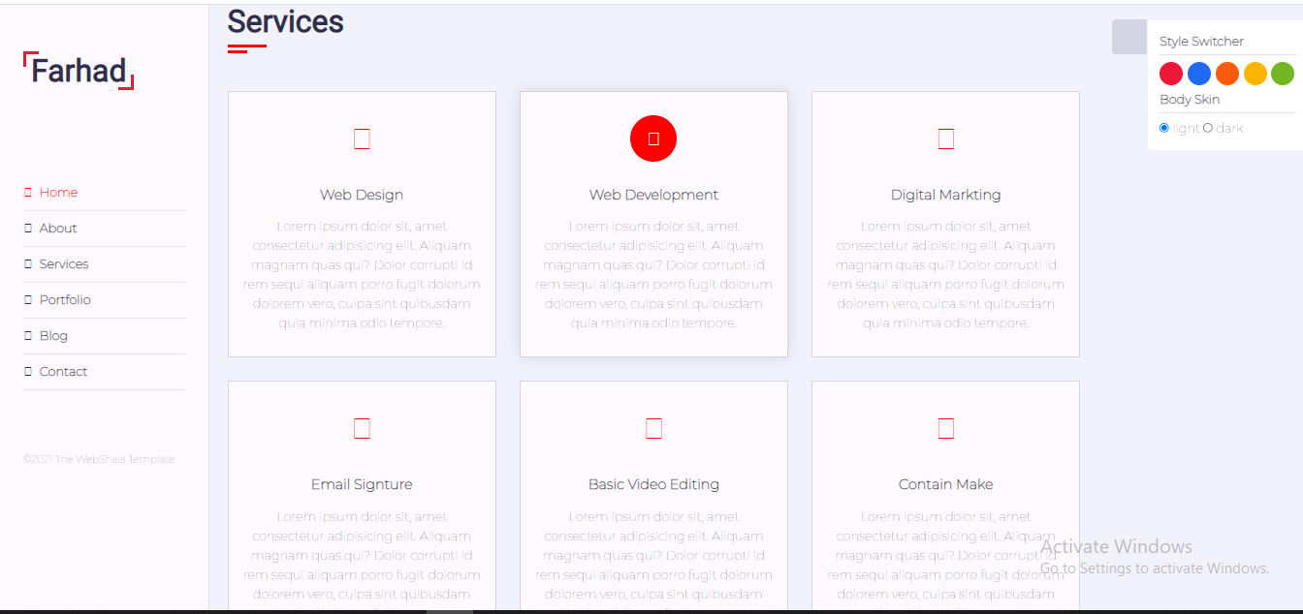
Services page

Slide 10
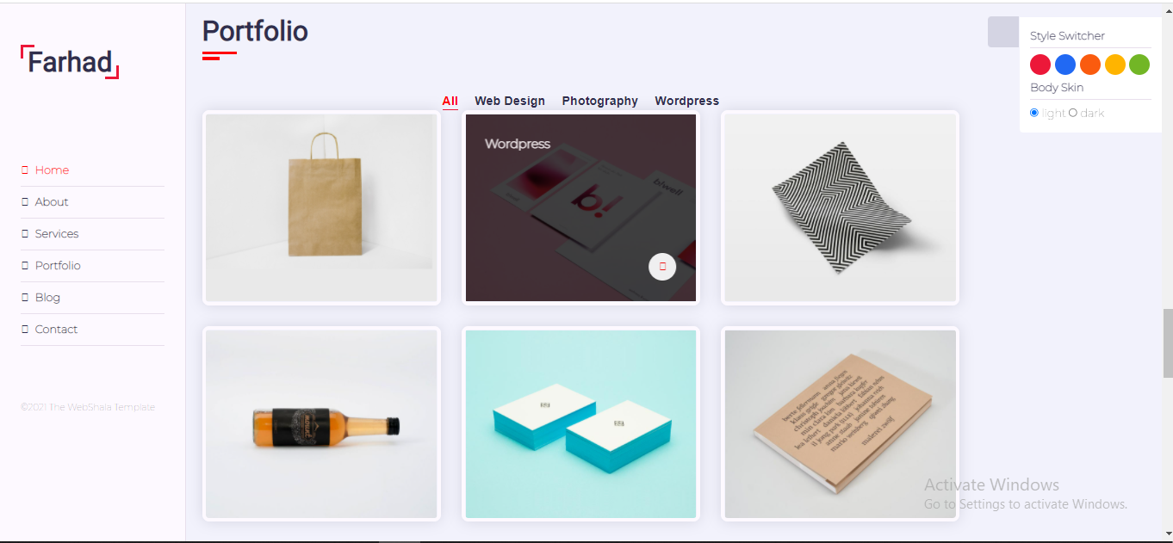
Portfolio page

Slide 11
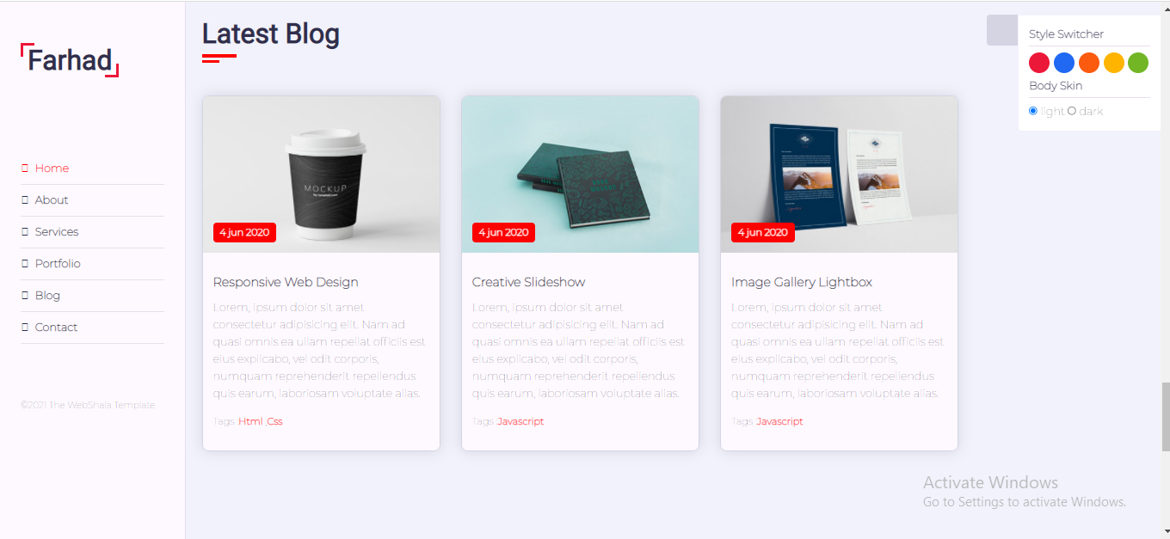
Blog Page

Slide 12
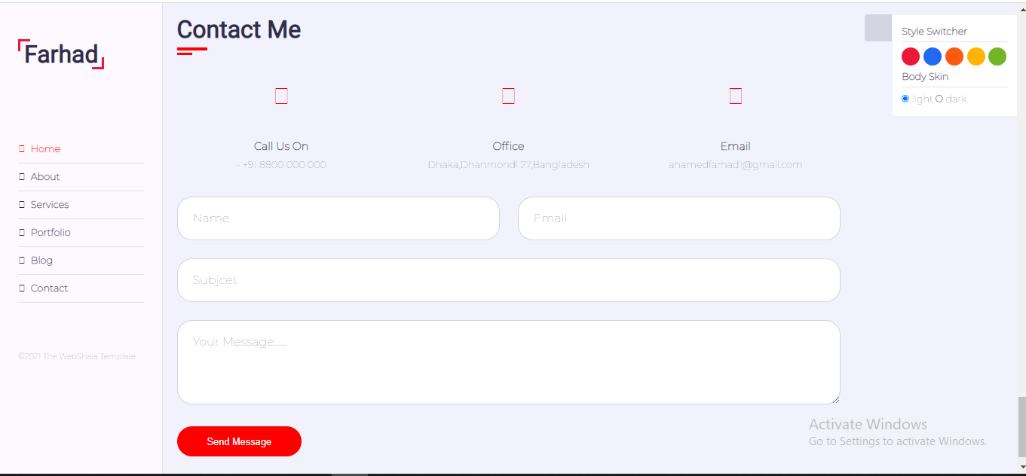
Contact page

Slide 13
Advantages
Accessibility
Portability
Creativity
Technology
Self-confidence
Community

Slide 14
Disadvantages
Disadvantages
The creation of digital portfolios requires advanced knowledge and skills and sometimes expensive, high-tech equipment.
Viewing a digital portfolio sometimes requires special software as well as additional knowledge and skills on the part of the viewer.
Technology can often obstruct the view of students’ REAL accomplishments by using too many ‘bells and whistles’.
Be aware of the possibility of plagiarism as it may be easier to use your information as it is already in a digital format and easily copied and pasted or saved onto another person’s computer.

Slide 15
Conclusion
Portfolios can enhance students' understanding of the impact of extracurricular activities, help them identify what they need to learn, identify their strengths and weaknesses, and help them understand how to modify their approach to learning.

Slide 16
Thank You All

